Slide 1
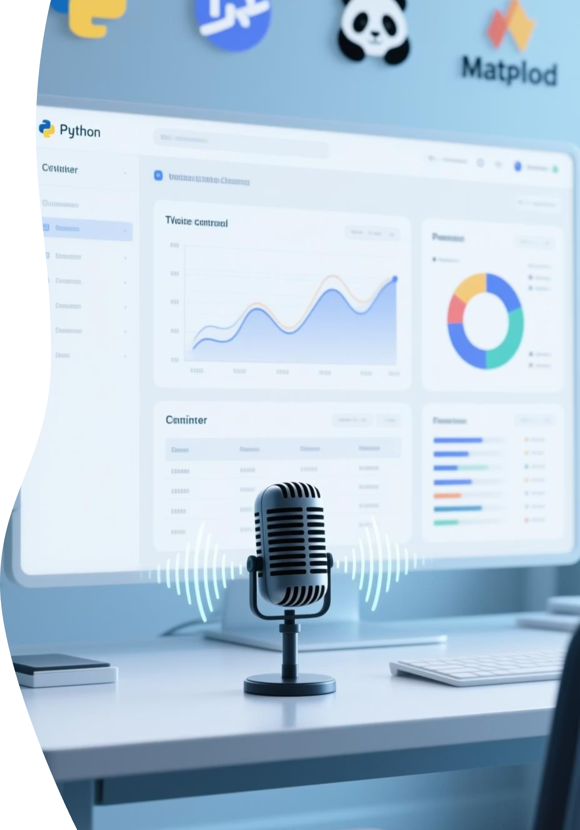
Speak2Data – Voice Analyst 🔊
A Voice-Controlled Data Cleaning & Visualization Tool

Slide 2


The Challenge: Data Accessibility
Introducing Speak2Data:
Speak2Data revolutionizes this by allowing users to speak commands to clean, filter, and analyze datasets. It makes data analytics accessible to non-technical users, empowering anyone to derive insights without writing a single line of code.
Data analysis often requires manual filtering and cleaning, a tedious and time-consuming process. Many users, particularly those without a technical background, struggle with coding or complex Excel functions. This creates a barrier, limiting who can truly leverage data.
The Problem: Data insights are locked behind technical skills.

Slide 3
Our Core Objectives
Voice-Driven Assistant
Empower Users
To build a robust, intuitive voice-driven data assistant that understands natural language commands.
Clean data (remove nulls, duplicates, invalids).
Filter by year, name, or price.
Generate charts and comparisons instantly.
Real-time Interaction
Exportable Results
Provide immediate, clear feedback with integrated text-to-speech functionality.
Allow users to export cleaned and filtered data into industry-standard Excel files for further use.

Slide 4




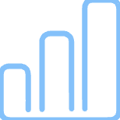


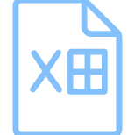
Technology Stack
Speak2Data leverages a powerful combination of Python libraries and APIs to deliver its voice-controlled analytics capabilities.
Python
SpeechRecognition
Core programming language orchestrating all components.
Google API for accurate voice-to-text conversion.
pyttsx3
Pandas
Enables clear text-to-speech responses from the system.
Robust library for efficient data manipulation, cleaning, and filtering.
Matplotlib
Tkinter
Generates diverse and customizable data visualizations.
Builds the intuitive graphical user interface.
Regex (re)
OpenPyXL/CSV
Extracts specific data points like years, names, and prices.
Handles saving and exporting results to Excel and CSV formats.

Slide 5

Intelligent Data Preprocessing
Before any analysis or command execution, Speak2Data meticulously preprocesses the loaded dataset. This ensures data integrity and readiness for accurate operations.
It loads datasets from common formats like .csv or .xlsx.
The Year column is converted to a numeric format for consistent temporal analysis.
String fields are normalized by converting them to lowercase and trimming excess whitespace, standardizing text data.
Invalid or missing values are systematically dropped or handled.
This robust preprocessing prepares the data for seamless cleaning, filtering, and advanced analysis, ensuring reliable insights.

Slide 6





Voice-Controlled Functions
Speech Input
Data Cleaning
Data Filtering
Commands are captured accurately via the integrated microphone, translating spoken words into actionable instructions.
Fill missing values (e.g., with mean).
Effortlessly filter datasets by key categories such as Year, Name, or Price ranges using simple voice commands.
Remove duplicate rows.
Trim whitespace from text entries.
Remove invalid or negative price entries.
Visualization
Export Results
Generate insightful charts including sales performance, revenue trends, and comparative analyses on demand.
Save cleaned and filtered data directly into Excel format, ready for sharing or further external analysis.

Slide 7
Real-World Commands
Speak2Data interprets natural language, making data manipulation intuitive. Here are some examples of voice commands and their immediate impact:
"Fill missing values with mean."
Calculates and inserts mean for empty numerical cells.
"Remove duplicates."
Identifies and deletes redundant rows from the dataset.
"Show data for 2021."
Filters the dataset to display only records from the year 2021.
"Filter records for Abhi."
Displays all entries associated with the name "Abhi".
"Compare Riya and Rahul revenue."
Generates a comparison chart or table of revenue for Riya vs. Rahul.
"Plot category sales chart."
Visualizes sales data broken down by product categories.
"Show yearly revenue trend."
Presents a line chart illustrating revenue changes over the years.

Slide 8
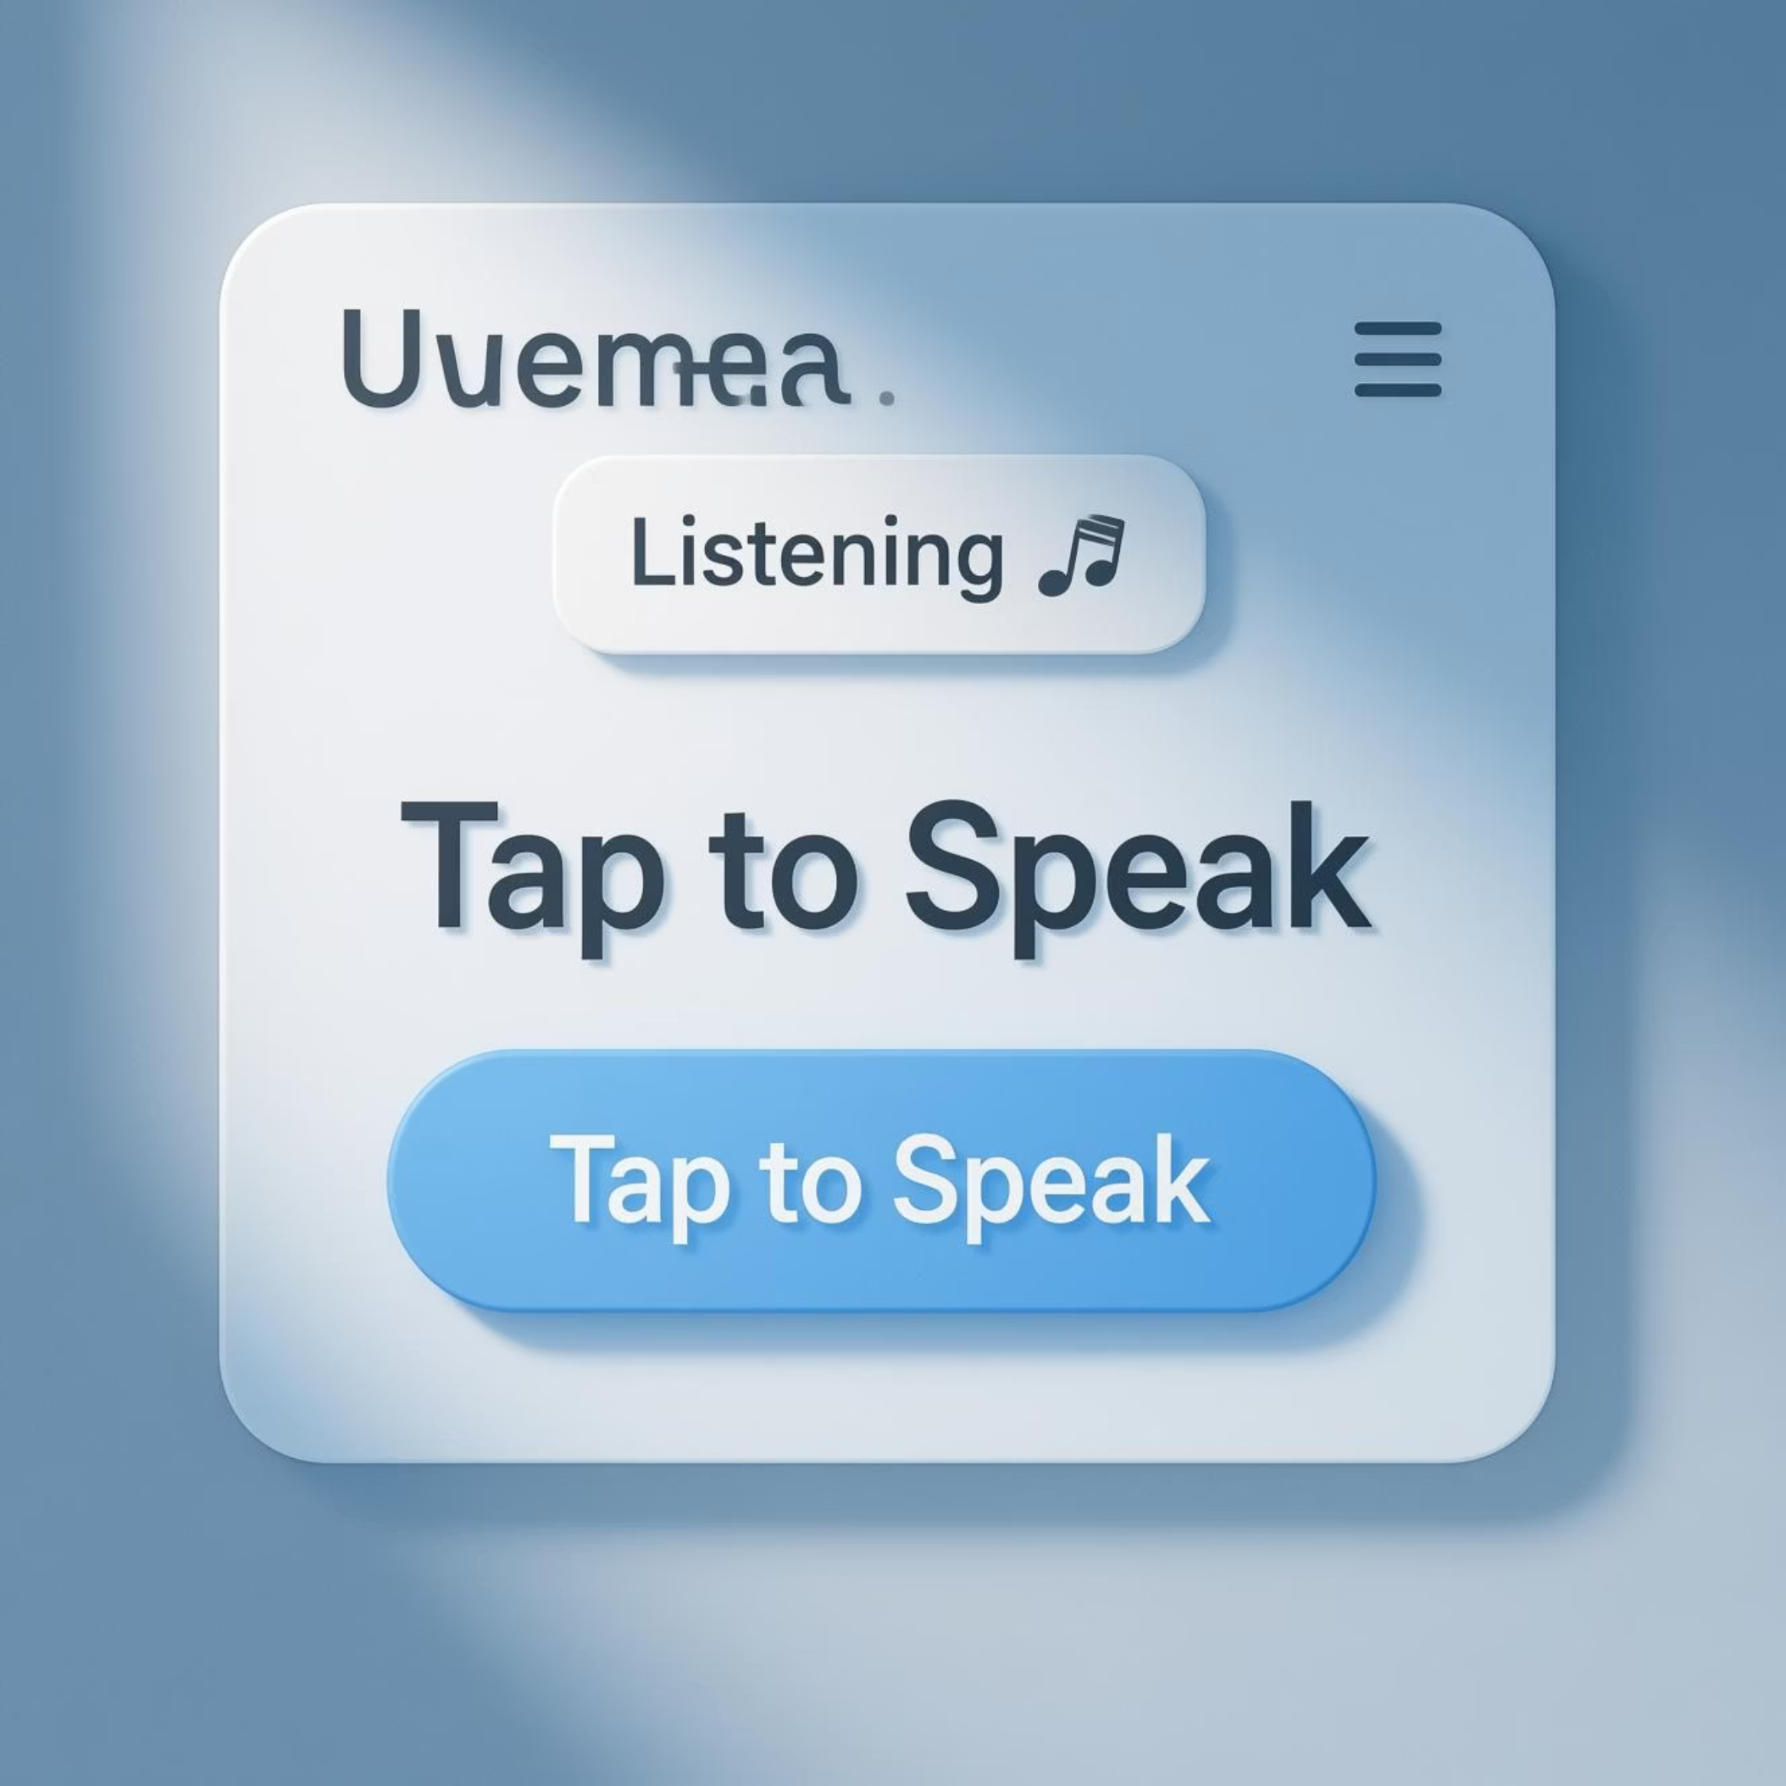
Intuitive GUI Design
The Speak2Data graphical user interface, built with Tkinter, prioritizes simplicity and user experience.
Title: Clearly labeled "Voice Analyst" at the top
for easy identification.
Tap to Speak Button: A large, prominent button serves as the primary interaction point for voice input.
Status Label: Provides real-time feedback to the
user on the system's state:
Listening 🎤
Processing 🧠
Done ✅
Error ❌
The background and elements are styled for optimal usability and a clean, modern aesthetic.

Slide 9



Key Advantages of Speak2Data
Hands-free Interaction
Accessible for All
Integrated Workflow
Seamlessly interact with your datasets using only your voice, freeing up your hands for other tasks.
Democratizes data analytics, making complex tasks simple and accessible even for non-programmers.
Combines data cleaning, filtering, and visualization into one fluid, voice-activated process.
Real-time Feedback
Automated Saving
Receive immediate, clear voice feedback, guiding you through each step of your data analysis.
Automatically saves processed results, ensuring your work is preserved for future analysis or sharing.

Slide 10


Conclusion & Future Vision
Conclusion:
Future Scope:
Speak2Data fundamentally redefines how users interact with data, providing a voice-first approach to analytics. It significantly reduces manual effort in data cleaning and filtering, making these critical tasks efficient and intuitive. Users can generate quick insights through voice-controlled charts and export capabilities, empowering them to make data-driven decisions faster.
The journey for Speak2Data is just beginning. Our future roadmap includes:
Advanced NLP: Implementing more sophisticated Natural Language Processing for even smarter, more complex natural language queries.
Database Integration: Expanding connectivity to popular
databases like SQL and MongoDB.
Scalability: Optimizing the system to support significantly larger
datasets and enterprise-level operations.
Platform Expansion: Developing mobile and web applications to make Speak2Data accessible across all devices and operating systems.

